Slide 1


Smart Legal Contract in Real Estate Field
#clbfest2018
Team Yoda

Slide 2

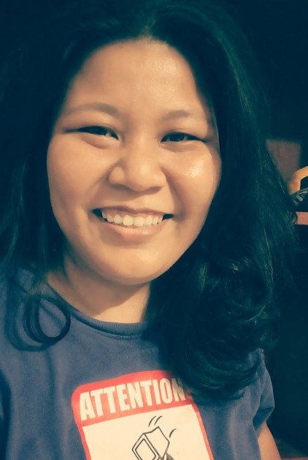
Team Yoda
HENDRA (30yrs/Hacker / Team Leader)
I am a passionate programmer. I call myself as perfectionist, realistic, but eager to learn new things to grow my capabilities. Now, I work as Lead Software Developer (Business Development Manager) of PT IONSoft.
Lists of my works (web and applications) are: Loebanget, Fotato, Pulsaku, and DIA.LO.GUE. I am familiar with several of mark-up and programming languages such as HTML, CSS, Javascript, PHP, Java, Kotlin, etc. My full resume can be checked via: https://hendrawd.github.io/ (link)
I participated in several Hackathon such as FinHack 2017, FWD Hackathon, C4TK, HackJak, Fishackathon
JULIE (38 yrs/Hustler)
I studied Journalism and didn’t have an IT background. During 2006-2010s, I was working as a property sales consultant for primary developers. Today, I am improving my skills and knowledge by studying Computer Science, Coding, Programming language, AI, Web and Mobile Development through MOOC sites like Edx or Udacity Google. I recently participate in AI Saturdays class at GOJEK to learn about AI and Data Machine.
My hackathon experiences were C4TK, HackJak (top ten nominator), Girls In Tech Hackathon and Fishackathon. I am a freelancer (editor and writer), and also an early-stage digital literary publishing startup founder. (Twitter/IG: @juleshwa)

Slide 3
Team Yoda’s links
Video/Youtube channel
Hendra Wijaya Djiono
Github /PDF/Presentation Kit
https://github.com/hendrawd/SmartREDS

Slide 4
PROJECT SUMMARY
Simple Contract Recording
User Friendly
Safe system
Validated Transaction
Automatically linked to related Government Ministries

Slide 5
OUR USERS
ESCROW AGENTS (e.g. Notary in Civil Law Jurisdiction)
REAL ESTATE DEVELOPER
REAL ESTATE BROKER AGENCY
BANK (in the future)
For this CLBFest 2018 challenge, we choose to focus in to Notary as the user of SmartREDS.

Slide 6
BRIEF EXPLANATION
Notary or PPAT as the escrow agent has the important role during real estate purchasing transaction. Notary, as the law representative, has the power such as:
To issue the legal real estate purchase agreement (Akta Jual Beli)
Request name changing process for every purchasing transaction (Balik Nama)
Validate the real estate's certificate of ownership (Sertifikat Hak Milik tanah dan bangunan)
Validate the transaction and real estate taxes payment
Etc

Slide 7
REGULAR LEGAL WORKFLOW
SELLER
PURCHASER
REAL ESTATE TRANSACTION
AJB/PURCHASE AGREEMENT
NOTARY /
PPAT
Validate Purchasing / Tax Payment
Land Registry /
Certificate of Ownership
The National Land Agency

Slide 8
REGULAR PROBLEM SETS
Too many papers for requirements and validation
Manual or semi digital validation / process
It takes plenty of time to get the certificate of ownership issued by The National Land Agency
Not automated register
The legal contract still needs to be printed, risk to be damaged or lost.

Slide 9
OUR SOLUTIONS
Smart Legal Contract
Simple recording and payment validation
Updated registry status
Automatically linked
(Future Development)
Cryptocurrency as transaction payment
Blockchain based database

Slide 10

SmartREDS flowchart
SELLER
PURCHASER
NOTARY /
PPAT
AJB/PURCHASE AGREEMENT
Population and Civil Registration Agency
Validate ID / Marital Status, etc
The National Land Agency
TAX AGENCY
Validate Purchasing / Tax Payment
BANK
Land Registry /
Certificate of Ownership
Other parties / agencies / related ministries

Slide 11

Conceptual Design
PLATFORM : Mobile & Desktop for Users recording
――――
―
Google Sheet
――――
―――
――――
RECORD DATA
Clause / legal contract template
USER
SERVER
Validation

Slide 12
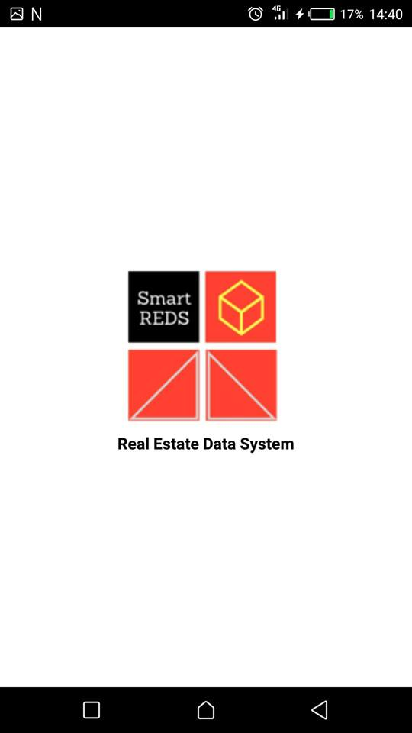
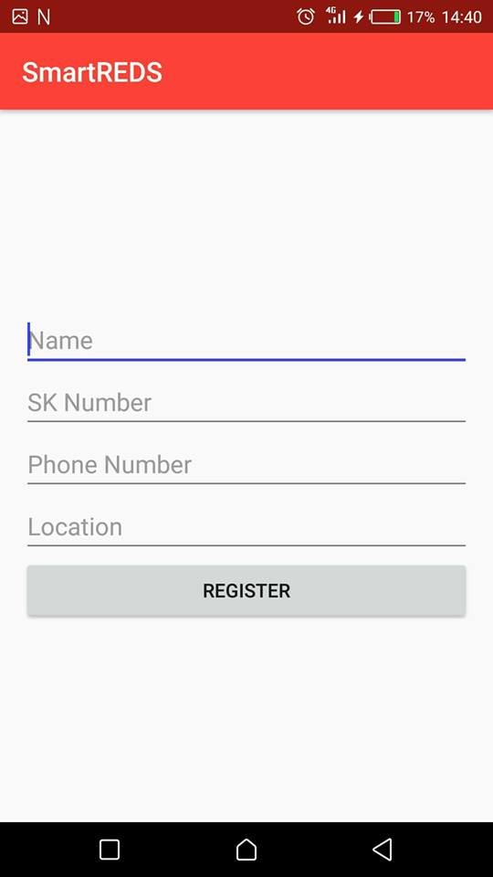
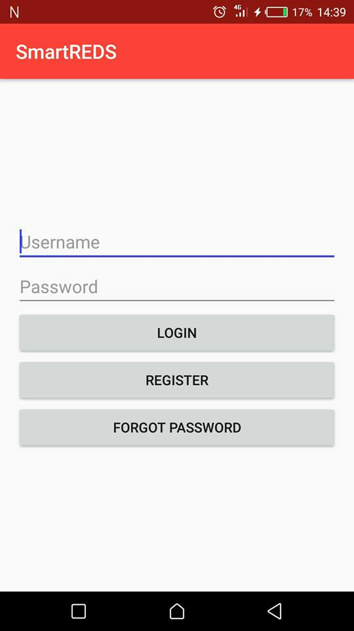
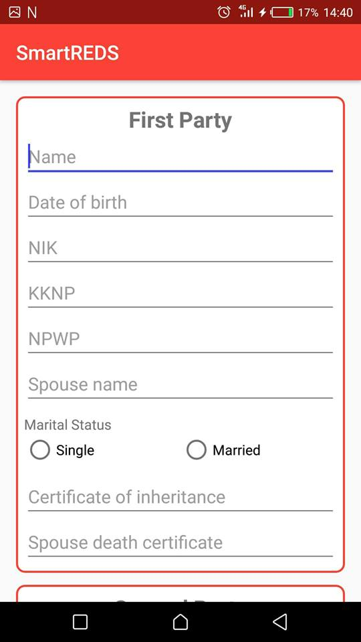
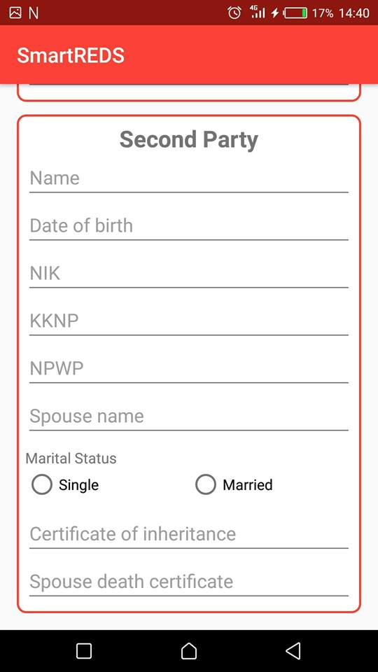
Screenshots
Standard App

Slide 13
End of Presentation
Thank you!

